Slide 1
LEVERAGING AI IN TESTING
MATERIALS, SLIDES, AND RESOURCES CAN BE FOUND AT HTTPS://GITHUB.COM/RACHELJOI/AIWORKSHOP
PNSQC 2024 – RACHEL KIBLER (LI: RACHELJOI) AND CARL KIBLER (LI: CARLKIBLER)

Slide 2
TOPICS
How to prompt the AI
Analyzing flowcharts and diagrams
Creating exploratory testing charters
Test data generation
Querying a database
Extracting information from application logs
Analyzing and improving code
Anchoring, bias, ethics, and pitfalls

Slide 3
INTRODUCTION – RACHEL KIBLER
In testing for nine years
Works at SeekWell (1-800 Contacts)
Lives in Salt Lake City, UT
Not an expert in AI, but an aficionado
Speaking about testing in five different countries this year

Slide 4
INTRODUCTION – CARL KIBLER
In tech for entire life
Head of Engineering at Lucerna Health
Lives in Salt Lake City, UT
Expert on AI, will go off about AI randomly

Slide 5
GOALS OF THE WORKSHOP
Become comfortable exploring with AI
Generate test cases, test data, and other artifacts
Evolve SQL and code
Iterate to improve
Understand the limitations
Prime you with ideas
Skill and comfort will come from play.
Notes:
Success in this workshop means you walk out of it feeling ready to do any activity that's part of software testing and also thinking about software testing.
You should feel ready to apply the workshop in the afternoon at your job – be more thorough, more certain, more creative, or begin self-learning skills related to testing. You shouldn't expect to be an expert, but you will see the path to expertise in that achieving really effective use of AI is achievable. Because it is.
EXPECTATIONS

Slide 6
EXPECTATIONS
55 minutes then 10 minute breaks
¼ lecture, ¾ exercises
Every exercise will have a debrief
Work with the people around you to keep things moving
Ask questions – we will answer or queue them for later
Notes:
Maybe note that people should save longer questions or thoughts till the debrief
Large class and lots of people have thoughts about AI. We will stop someone if needed to keep moving

Slide 7
WHAT IS SUCCESS TO YOU?
How many of you have used ChatGPT (or similar) for any reason?
How many of you have used it for fun?
How many of you have used it for work?
What do you want to learn?
Notes:
We have a lot of content and possible directions for this workshop. Before we get started, let's collect your specific requests, ideas, and preferences for what does success mean for you. What do you want to learn and we will customize to doi as many as possible.
Throughout the rest of the conference, either of us are happy to talk with you about these topics to either: 1. Go into more details
2. Talk about core concepts of AI
3. Talk specific tools
4. Or anything else we can’t get to in the workshop
Reach out and grab us if you see us around. Happy to talk.

Slide 8
STATE OF AI
”AI” is currently mostly Large Language Models.
OpenAI’s ChatGPT Anthropic’s Claude Mistal
Google’s Gemini Meta’s Llama and endless variations
Decades of accumulated techniques got good enough.
Then the math got fast enough
A strong laptop can run useful AI sort-of fast enough to use if you need to do it locally (LM Studio, Ollama)
Notes:
The models are roughly equivalent in capability. Every few months a new version slides ahead of the others in 1 area to be beaten a month later by another.
ChatGPT goes from 4 to 4o to 4o-mini. Claude goes from 3.0 Sonnet to 3.0 Opus to 3.5 Sonnet. Llama model goes from 3 to 3.1 and so on.
If it's important to you or a company that no data ever leaves your work computer to an outside entity, regardless of the data controls and security vendors like OpenAI or Anthropic provide, there are fairly easy ways to run open source models locally. So you can run Llama and Mistral, various versions of those on your local machine if it's sufficiently powerful. Or you could push for your IT department to set up a large instance. The point is that these are getting faster, cheaper, smarter all the time. But they're all on a pretty great base level. Versions from the last six months of any of these can do anything that you really need to do.

Slide 9
“GENERATIVE” MEANS IT WILL INVENT
GPT is Generative Pre-trained Transformer
Given a prompt, you will get output
[unless it thinks you’re breaking a rule]
It will sound authoritative
It will be convincing
It will make things up

Slide 10
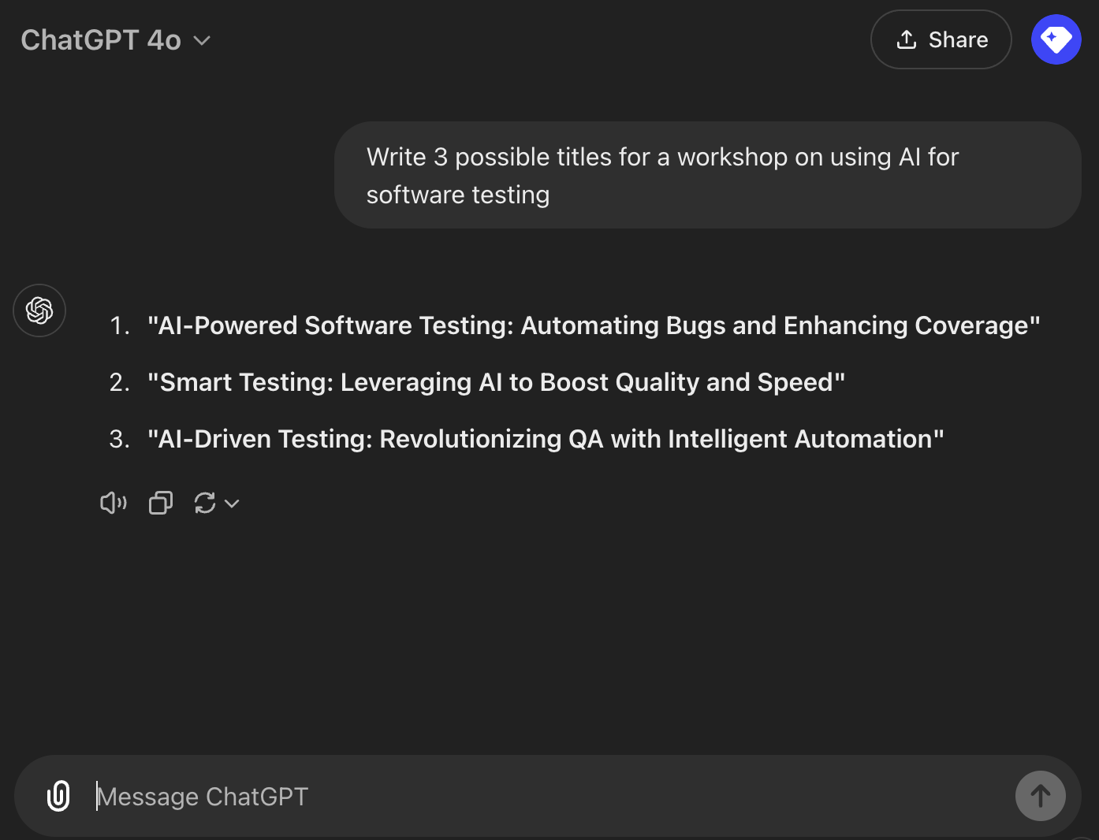
EVOLVING INTERFACES

Slide 11
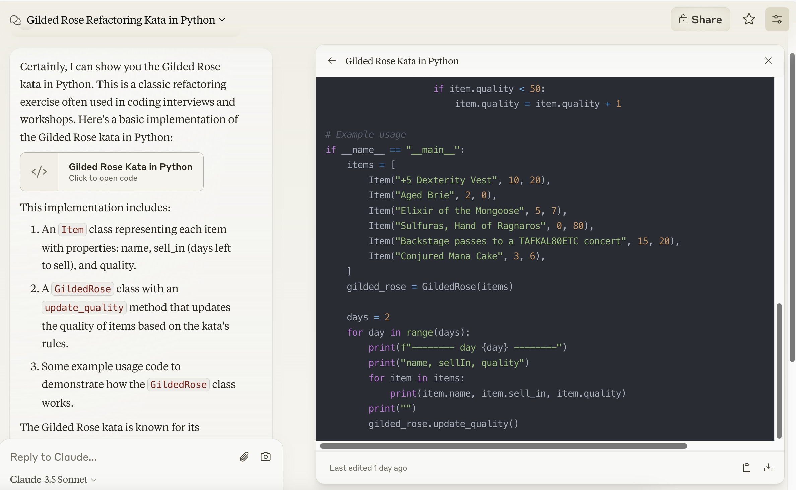
EVOLVING INTERFACES

Slide 12
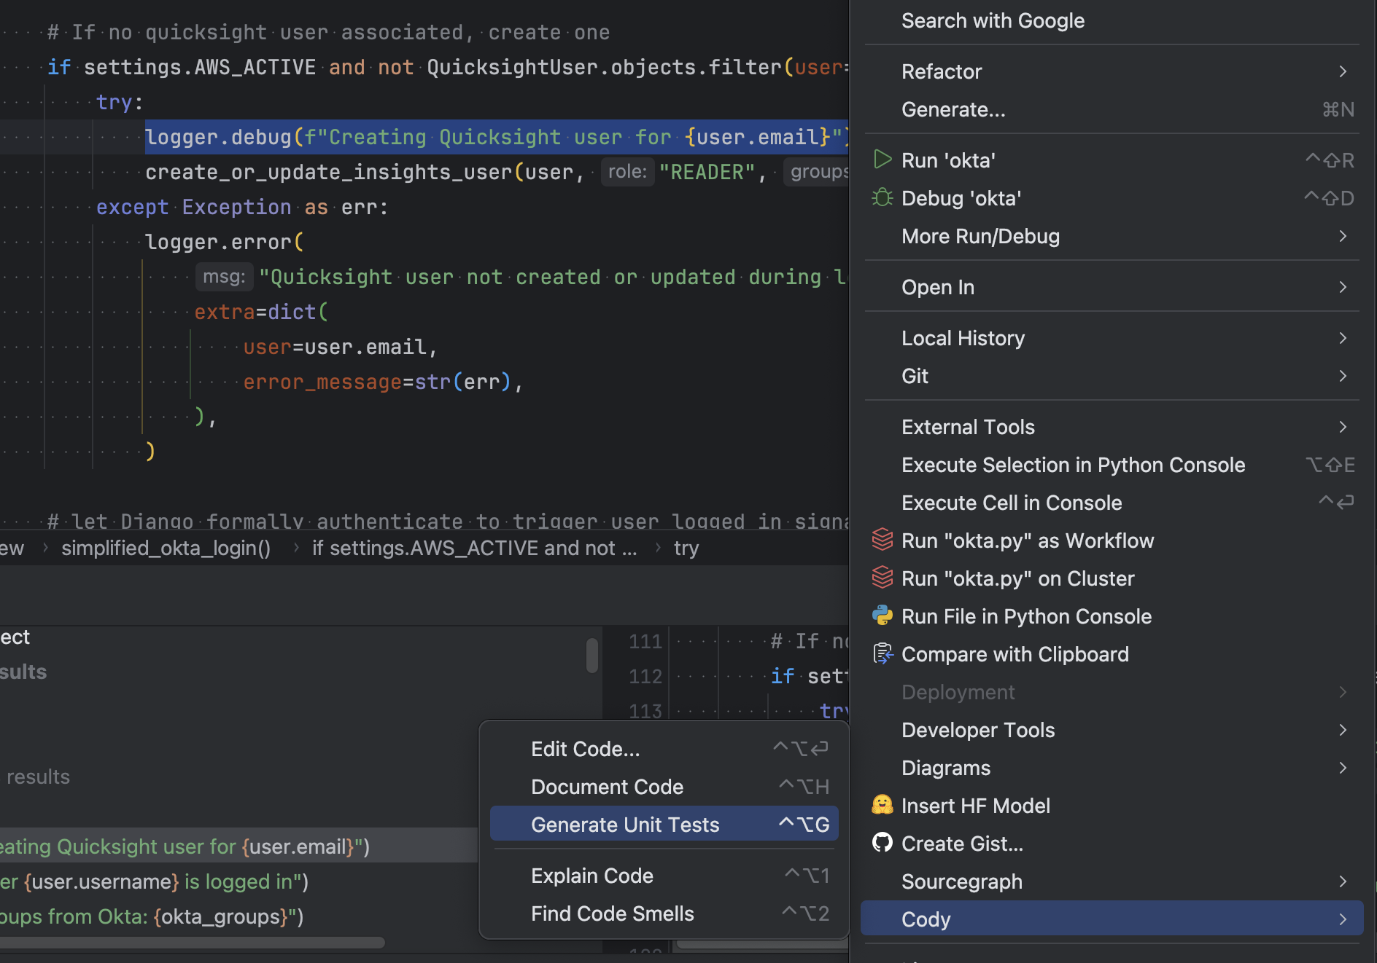
EVOLVING INTERFACES

Slide 13
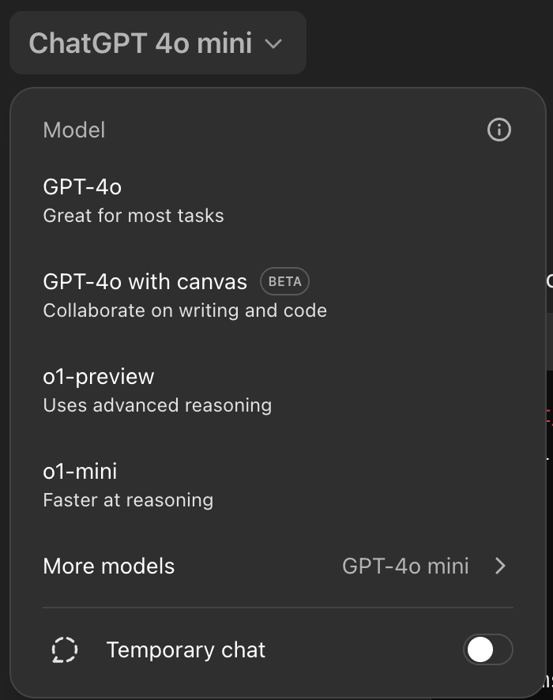
FREE TIER LIMITS
1. Limited queries to GPT-4o
2. Switch to GPT-4o mini if you need
There’s not a huge difference

Slide 14
PROMPTING

Slide 15

PROMPTING IS DIRECTING
Prompts are about context
Conversation means asking plus telling
You must provide the mindset
“prompt engineering” is the term for thoughtfully constructing queries to get specific, controlled responses
Notes:
These are the core ideas that we're going to keep referring to throughout the workshop. We're going to do exercises and discuss outcomes. We're going to keep bringing the ideas back to increasingly large understanding of these ideas and how you can look at the process of how you're working with AI. And remember these ideas keep improving.
First, prompts are about context. You will see that the way you give context, that is, tell the AI what you're trying to do and why and how. The more you do it, the better and the more specific, customizable the results will be.
Working with AI is fundamentally a conversation. And this means... You can tell the AI to do things. It can respond back. It can respond like, "It can ask me things." It can talk you through the processes. It can explain itself. It can hear your thoughts and ideas and then generate a ring from back and create this continuous flow of thoughts, which is limited as AI. It can be, sometimes. It's conversation, it's idea, it's a thinking partner. So if you talk to it, in a conversational style, it will help you think. And yes, it can output mechanical, kind of a word. It can output ideas. Fundamentally, it's doing this accelerating your thinking. Which brings us to the third core idea, which is you have to read the mindset. This vast group of human talking to a computer, talking to a human talking to a computer. You're the one who has to make sure you're talking about the right thing. And at the right level. You have to be... to sometimes say, "Stop." You need to think at a higher level. We need to approach this completely differently. So you have to realize that we're watching the process and guiding a conversation to where you want it to go.

Slide 16
LEARN TO SPEAK THE LINGO
You are the visitor in this foreign country
Talk about everything
Learn the phrases
Develop a map of the neighborhood
Ramble. Push. Prod. Be silly. No embarrassment.
Notes:
You are now in a foreign country
You know basic commands and questions
You can rapidly learn nuances and complex phrases
Develop a map by wandering around
Don’t be afraid to back up and change directions
Have an exploratory mindset
Learn the AI’s weaknesses, strengths, and patterns
Ramble. Push. Prod. Be silly.
No embarrassment.

Slide 17
WHAT DO YOU REALLY WANT?
Write a poem
Write a funny poem about subtly calling out someone in retro
Write a funny poem about subtly calling out Dave in retro. Choose 3 poets and mimic their styles
Notes:
The more thought you put into explaining what you want from the AI, giving it useful data and context, and guidance on the outputs, the better the result will be. Just like with a human.
Ending: Let’s start exploring

Slide 18
TEST IDEA GENERATION
Notes:
Prompting is about giving as much of your own tacit knowledge to the AI as it needs to complete the task. It will never have all the context you do but need to craft your prompt to give it as much context as you can.
You are start with a terrible prompt and get better.

Slide 19
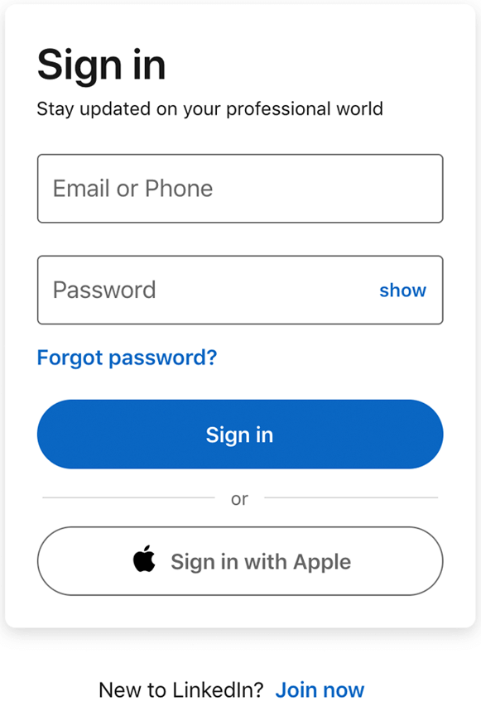
EXERCISE: PROMPT ME, BABY, ONE MORE TIME
Talk to the AI about this login page.
How far can you go? What can you generate?
Did you ask it for bad inputs?
Edge cases?
Ask it for ideas?
Tell it “you are an expert who cares about details and creativity”?
Ask it to organize its output into a different format?

Slide 20
BETTER OUTPUTS
You cannot “give the AI more time” but you can request it to do more internal thinking as it responds.
Instruct it to:
Show the steps you’ve given it
Check the work

Slide 21
DIAGRAMS, CHARTS, VISUALS
Notes:
We don’t want to overlook the non-text capabilities of AI. First, voice recognition suddenly got amazing. Voice output is much better. AI can suddenly understand images and video and generate them.
This is a great new tool in our testing! We can chat with the AI while we both look at the same thing.

Slide 22
EXERCISE: FLAUX PAS
Draw a flowchart of something you know:
User login and password reset
Process of checking out from a retail website
Send image to the AI and discuss
https://shorturl.at/NZUUw
Notes:
1. Did they ask it for ELI5?
2. Missing steps?
3. Flaws?
4. Risks?

Slide 23
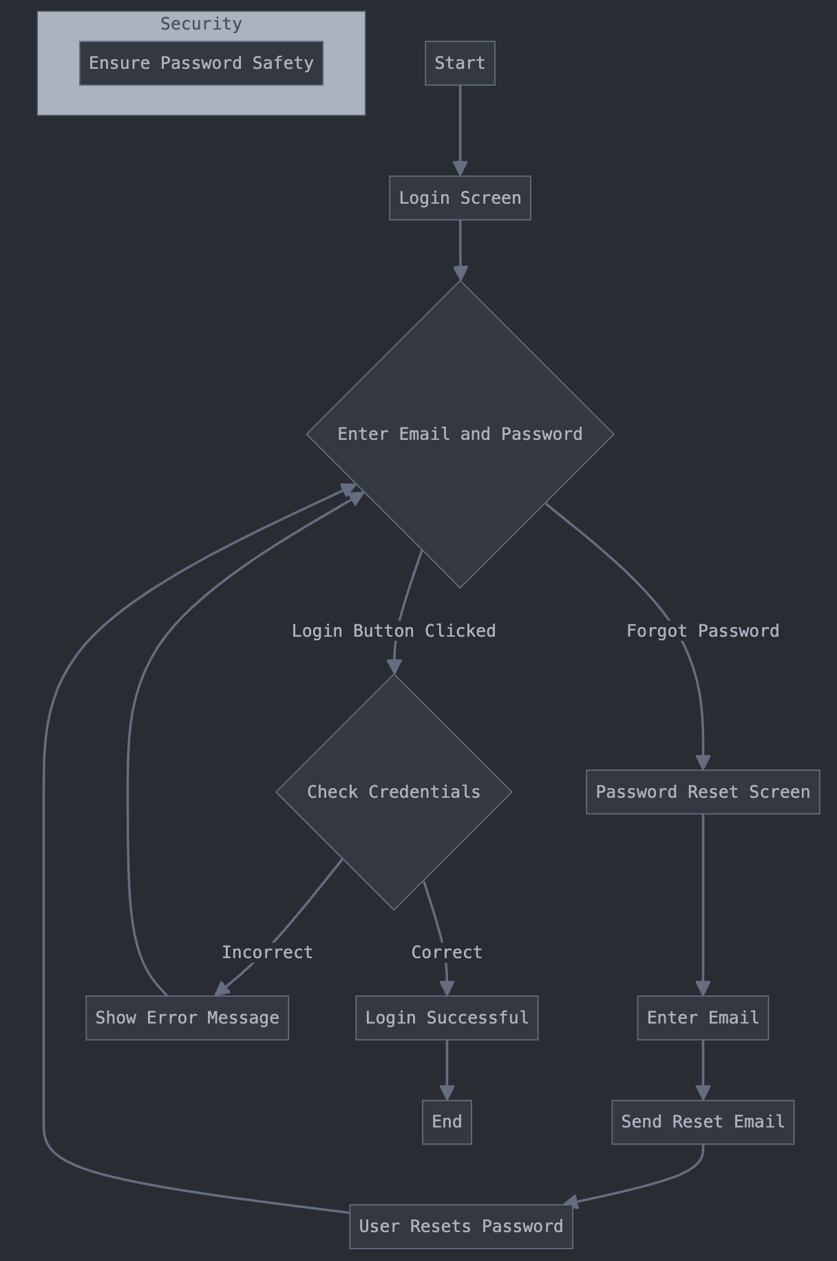
Draw
Send image
Discuss
Evolve

Slide 24
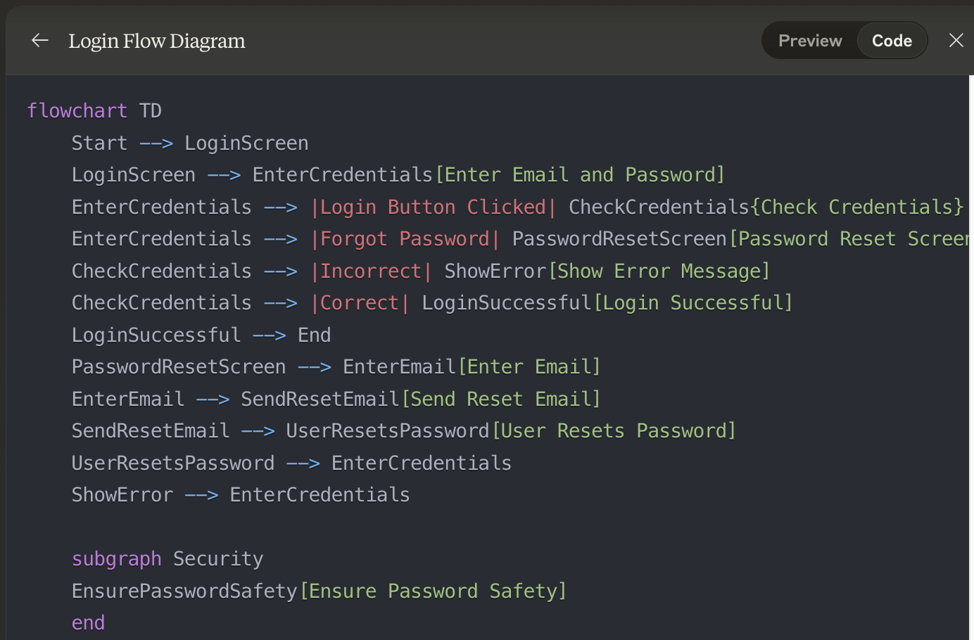
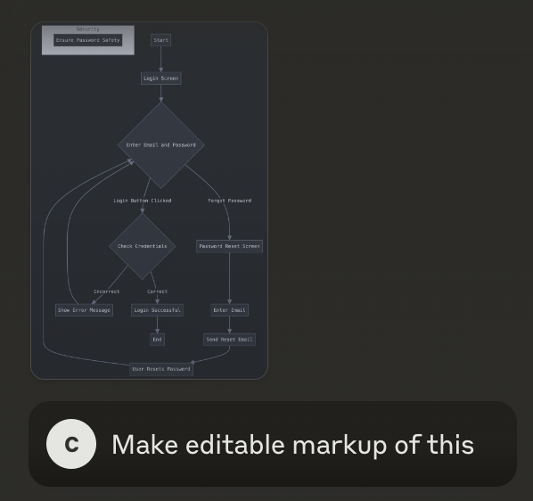

Slide 25
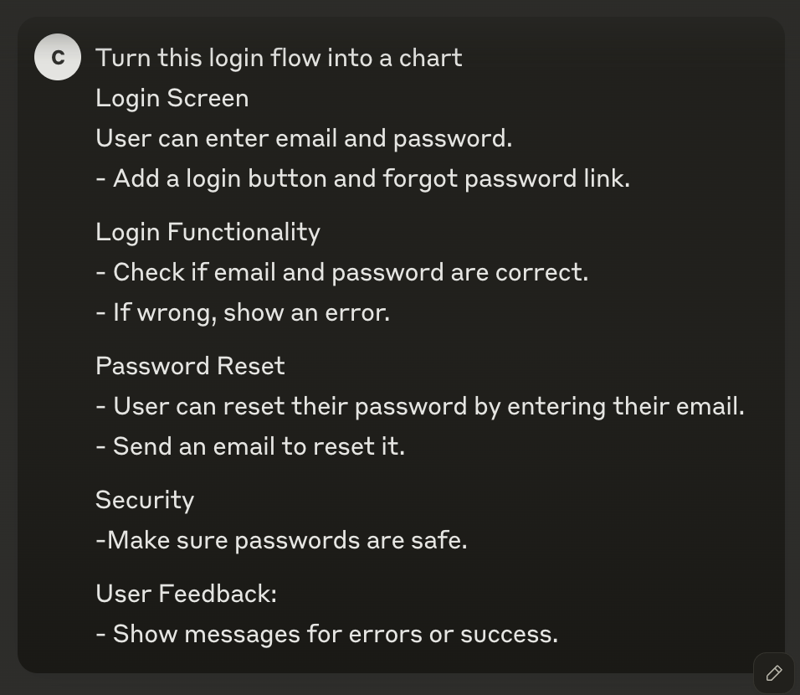
TEXT INTO FLOWCHARTS

Slide 26
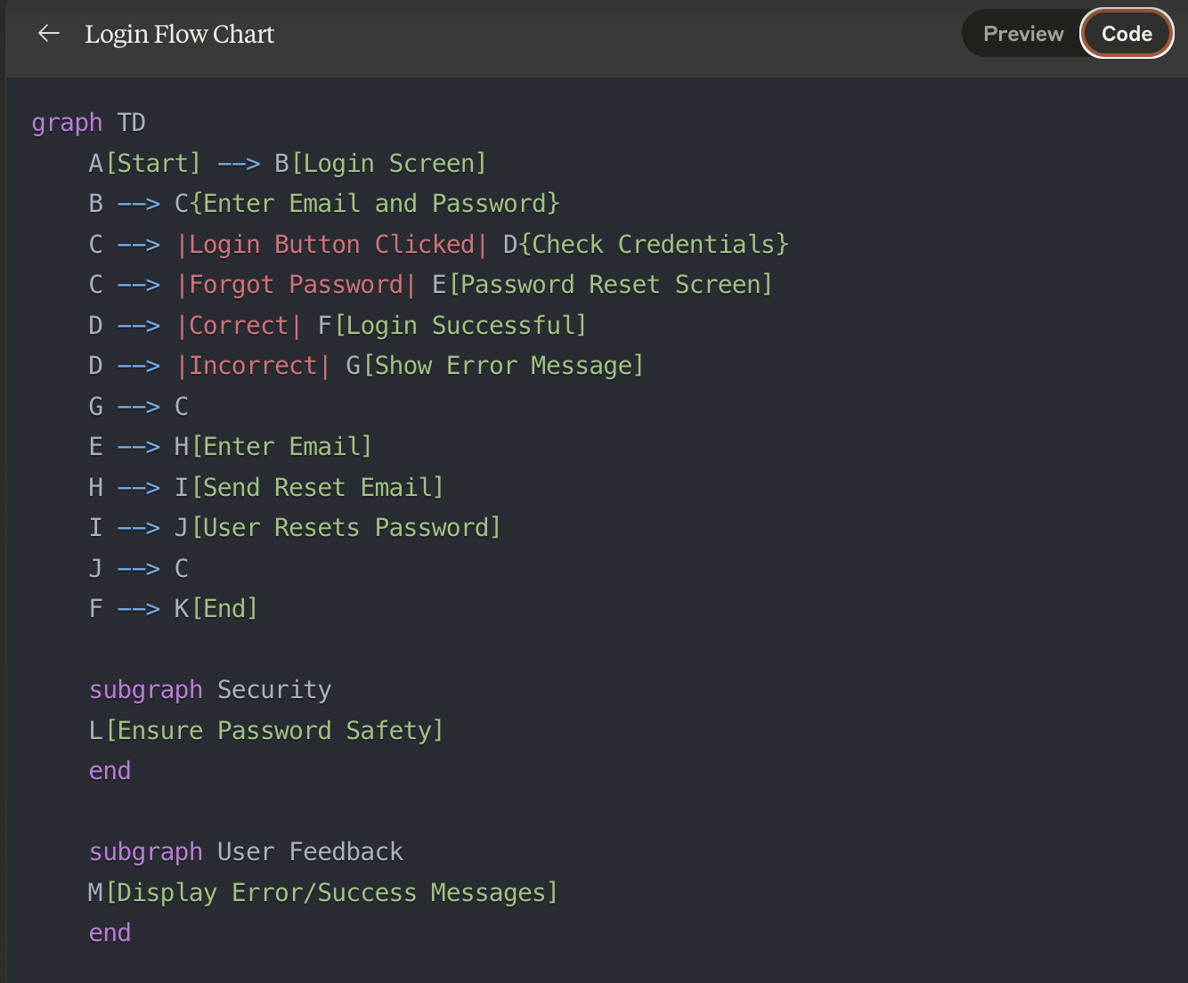
TEXT INTO FLOWCHARTS

Slide 27
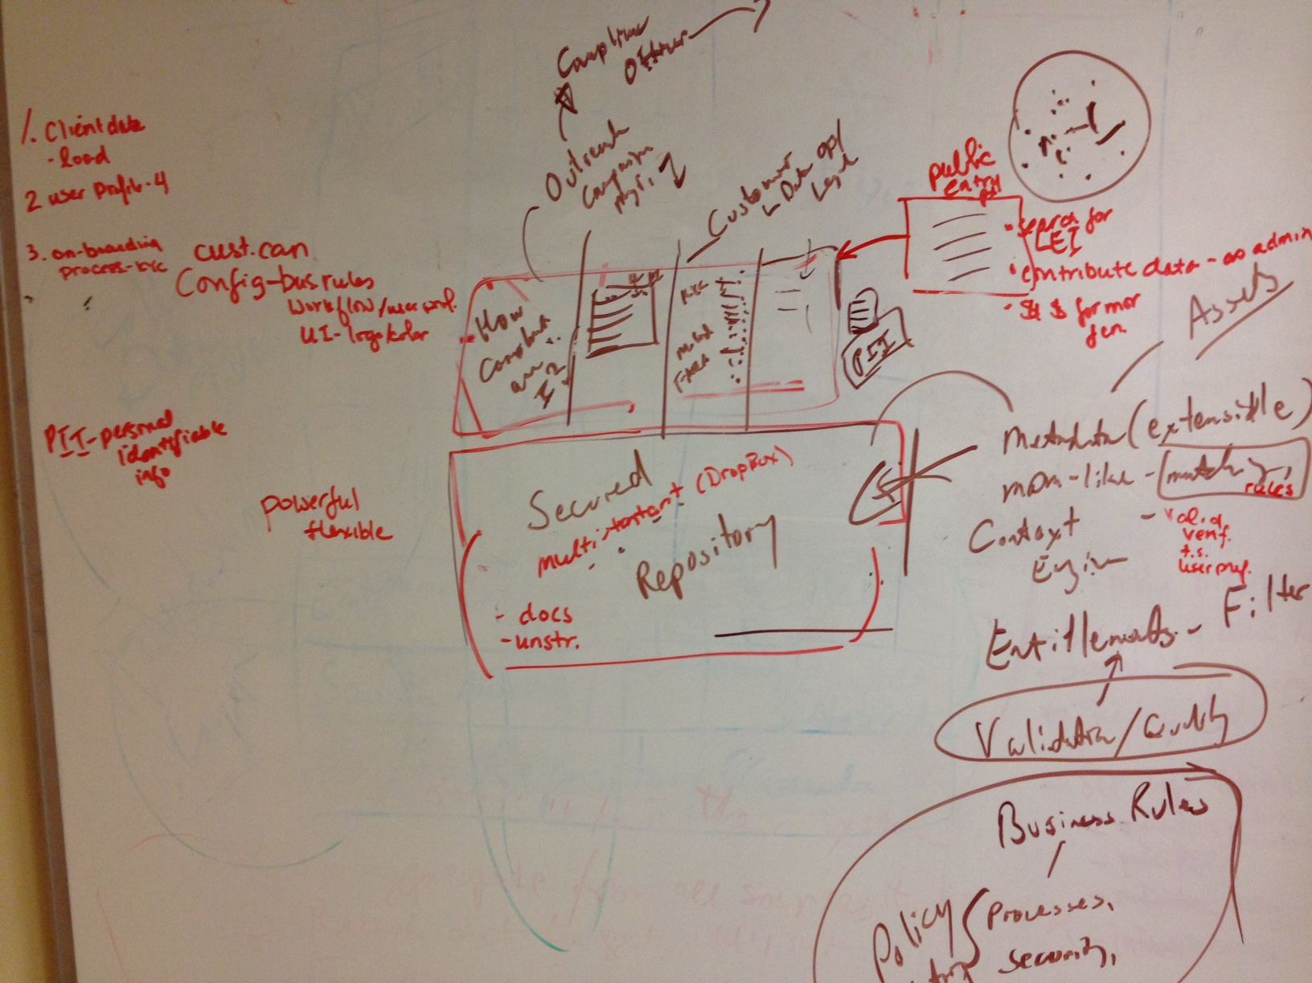
MESSY WHITEBOARDS ARE FINE
Notes:
Using its analysis of the diagram, create exploratory testing charters
We asked AI to generate risk ideas. We want an exploratory testing charter

Slide 28
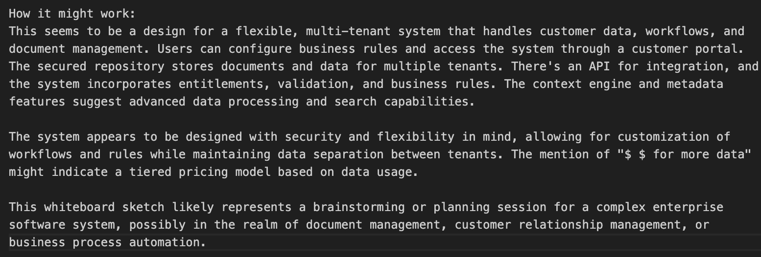
MESSY WHITEBOARDS ARE FINE
Notes:
Using its analysis of the diagram, create exploratory testing charters
We asked AI to generate risk ideas. We want an exploratory testing charter

Slide 29
EXERCISE: DORA THE EXPLORER
Diagram (PNG file): https://shorturl.at/ZAtS9
Notes:
This is an exploratory testing charter creation exercise. Analyze the diagram for risk and create 3 testing charters based on:
Explore <Target> using <Resource> to discover <Information>

Slide 30
10 MINUTE BREAK
Next up: Data generation, databases, and querying

Slide 31
TEST DATA GENERATION
Mechanisms:
Manual – Testers manually create test cases and corresponding data
Random – Libraries create data in bulk
Synthetic – Mimic properties of real data
Anonymization – Make real data safe

Slide 32
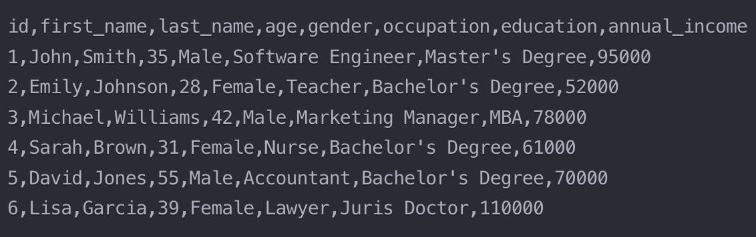
Naïve AI-GENERATED DATA
Create 6 records of person demographic data in CSV format
Notes:
What do you notice?
1. Simple anglo names
2. All adults
3. Professions and other employed aspects
What’s missing? Kids. Names from Turkey, China, Brazil. Addresses. Domain-relevant

Slide 33
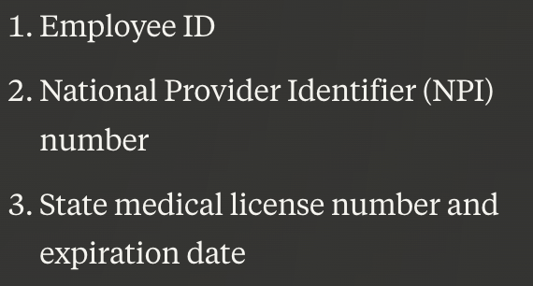
EXERCISE: IT’S MADE OF PEOPLE
Generate data of doctors employed at a hospital
Evolve to contain:
Address
Education
Residency
Languages spoken
Create 6 records of person demographic data in CSV form. This is doctors employed at a hospital. Use realistic data.
List other important properties I might need to store.

Slide 34
EXERCISE: THE MATRIX, LOADED
First: go to www.database.build and link your Github account
Next: LET’S DO THIS!!!
See “Testing Prompts” in https://github.com/racheljoi/AiWorkshop
Notes:
Postgres.new

Slide 35
EXERCISE: THE LOGFATHER
We’re going to query some logs!
You’ll need to get to the Github repo for this workshop: https://github.com/racheljoi/AiWorkshop/tree/main/ErrorsExercise
You can also access the Github from the link on www.apparentintelligence.com

Slide 36
10 MINUTE BREAK
Next up: Exploring code

Slide 37
WORKING WITH CODE

Slide 38
EXERCISE: INSPECT-A-GADGET
Explaining and analyzing code:
Generate a roman numeral converter
Or
Show me the gilded rose kata
Generate it like a beginner, experienced, and expert
Tell it to analyze the code
List potential weaknesses, improvement
Notes:
- AI has made working with code easier. To understand it, write it, and test it. AI can help explain code. Discuss it, generate tests, and do surgical changes.
- Ask it anything you want
- Silly is fine!

Slide 39
EXERCISE: CODE TREK – THE NEXT ITERATION
How can we make the code better?
Walk me through refactoring this code
did you add say ‘safely refactoring’?
Walk me through safely refactoring this critical code. List and explain steps and show your work for each step.

Slide 40
PRODUCING BETTER CODE AND TESTS
Good context
Acting direction
Require thought plus result

Slide 41
PRETTY GOOD PROMPTING
Generate a roman numeral converter in python. You are an expert, thoughtful engineer and tester. List edge case inputs and check that the code handles them. Write a commit message and concise summary for a pull request.

Slide 42
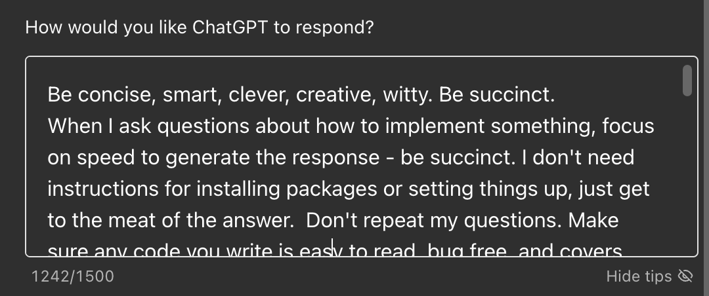
SYSTEM PROMPT

Slide 43
EXERCISE: ANCHORS AWAY!
Without using AI, write down as many items as you can that are found in a kitchen. You have thirty seconds!
Without using AI, write down as many colors as you can that are not shades of blue. You have thirty seconds!
How did you do?

Slide 44
PROMPTING Q&A

Slide 45
10 MINUTE BREAK
Next up: Ethics and pitfalls

Slide 46
ETHICS & PITFALLS
Data it was trained on
Systems it was trained on
Environmental impact
Can lie or hallucinate
Sharing private data
Notes:
Do not trust
Statistics / numerical data
Bibliographic references
Links to websites
Watch out for
Bias
Contextual drift
SEO punishment of AI-written content
Sharing intimate data

Slide 47
OTHER USES FOR AI
Demo: Creating FAQs from testing notes
Demo: Templates for bugs or design docs

Slide 48
ACTION ITEMS
What will you do next?
Try AI analysis for:
Concrete steps
Related ideas
Plan over time
Follow-ups? Questions?
Rachel Kibler
Tester, Speaker, Trainer
LI: racheljoi
rachel@kibler.tech
Carl Kibler
Engineer, Speaker
LI: carlkibler
carl@kibler.tech

